Slide 1

Propositional Logic
School of Computer Science UPES, Dehradun
India

Slide 2
Table of Contents
Introduction to Logic
Propositional Logic Overview
Truth Tables
Propositional Logic Connectives
Laws of Propositional Logic
MCQs
Key Points
References

Slide 3
Learning & Course Outcomes
LO1: To understand the concept of propositional logic
LO2: To learn to design truth tables
LO3: To apply various connectives and understand the laws of propositional logic
CO1. Understand the basic concepts and techniques of Artificial Intelligence.

Slide 4
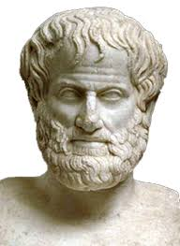
Introduction to Logic
What is Logic?
The study of principles and methods used to distinguish correct reasoning from incorrect reasoning.
Father of Logic
Aristotle (384–322 BCE): Often considered the "father of logic," Aristotle developed the first formal system of logic, known as syllogistic logic. His work, particularly in "Organon," laid the groundwork for future logical studies.

Slide 5

Introduction to Logic
Logic is the basis of all mathematical reasoning and all automated reasoning. The rules of logic specify the meaning of mathematical statements. These rules help us understand and reason with statements such as –
Which in Simple English means “There exists an integer that is not the sum of two squares“.

Slide 6
Propositional Logic
Propositional logic is also known as propositional calculus or sentential logic.
It is a branch of logic that deals with propositions and their relationships through logical connectives.
It forms the foundation for many areas of formal logic, computer science, and mathematics.

Slide 7
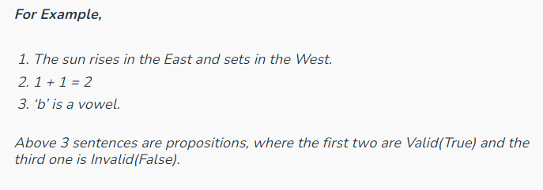
Propositional Logic
Propositional logic is a branch of mathematics that studies the logical relationships between propositions (or statements, sentences, assertions) taken as a whole, and connected via logical connectives.

Slide 8
Propositions
A proposition is a declarative statement that is either True or False but not both.
Examples include:
"It is raining" (True or False)
"2 + 2 = 4" (True).
Go out and play # not a preposition
What time is it? # not a preposition

Slide 9
Logical Connectives
Connectives: Symbols representing logical operations.
Types of Connectives:
Negation (¬) : The negation of a proposition P is denoted as ¬P and is True if P is False, and False if P is True.
Conjunction (∧) : The conjunction of propositions P and Q is denoted as P∧Q and is True if both P and Q are True.
Disjunction (∨) : The disjunction of propositions P and Q is denoted as P∨Q and is True any one of P or Q is True.
Implication (→) : The implication P→Q is true if whenever P is True, Q is also True. It is False only if P is True and Q is False.
Bi-implication (↔) : The biconditional P↔Q is true if P and Q are either both True or both False.

Slide 10
Logical Connectives
P→Q is equivalent to:
¬P∨Q: This is the disjunction form, meaning "Not P or Q.”
¬Q→¬P: This is the contrapositive form, meaning "If not Q, then not P."

Slide 11
Logical Connectives
P ↔ Q is equivalent to:
(P→Q)∧(Q→P): This means "P implies Q and Q implies P.”
¬P↔¬Q: The biconditional is preserved under negation, so "Not P if and only if Not Q.
(P∧Q)∨(¬P∧¬Q) : This is the expression for logical equivalence, meaning "P and Q are both true, or P and Q are both false."

Slide 12
Truth Tables
Purpose: Systematically determine the truth value of compound propositions.
Construction: Assign truth values to variables and apply logical connectives.
Example: Truth table for (𝑝∧𝑞)∨¬𝑝

Slide 13
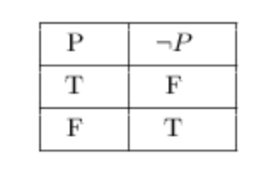
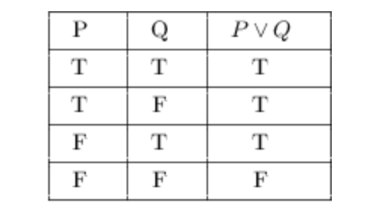
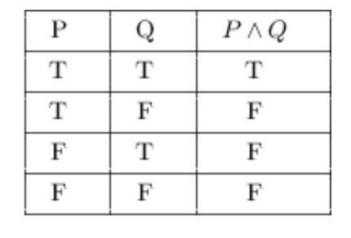
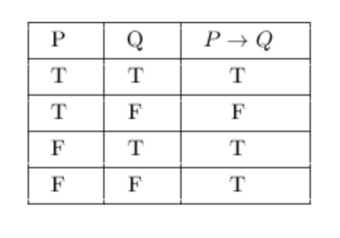
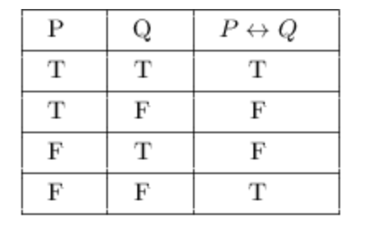
Truth Table Examples
For a detailed tutorial on Truth Tables, please refer to: https://sites.millersville.edu/bikenaga/math-proof/truth-tables/truth-tables.html

Slide 14
Laws of Propositional Logic
Commutative Laws: 𝑝∧𝑞 ≡ 𝑞∧𝑝
Associative Laws: (𝑝∧𝑞)∧𝑟 ≡ 𝑝∧(𝑞∧𝑟)
Distributive Laws: 𝑝∧(𝑞∨𝑟) ≡ (𝑝∧𝑞)∨(𝑝∧𝑟)
De Morgan's Laws: ¬(𝑝∧𝑞) ≡ ¬𝑝∨¬𝑞
Idempotent Laws: 𝑝∧𝑝 ≡ 𝑝
Example: Applying De Morgan's Law: ¬(𝑝∨𝑞) ≡ ¬𝑝∧¬𝑞

Slide 15
Examples
Simplify the expression ¬(p∨q)∧(p→q)

Slide 16
Solution
Simplifying the expression ¬(p∨q)∧(p→q)
1. Apply De Morgan's Law to ¬(p∨q) :
¬(p∨q)≡¬p∧¬q
2. Apply the definition of implication to p→q:
p→q≡¬p∨q
3. Substitute these into the original expression:
(¬p∧¬q)∧(¬p∨q)
4. Distribute ¬p across (¬p∧¬q) and (¬p∨q) :
(¬p∧¬q)∧(¬p∨q)≡(¬p∧¬q∧¬p)∨(¬p∧¬q∧q)
5. Simplify the expression:
(¬p∧¬q∧¬p)∨(¬p∧¬q∧q)≡¬p∧¬q
So, the simplified expression is:
¬p∧¬q

Slide 17
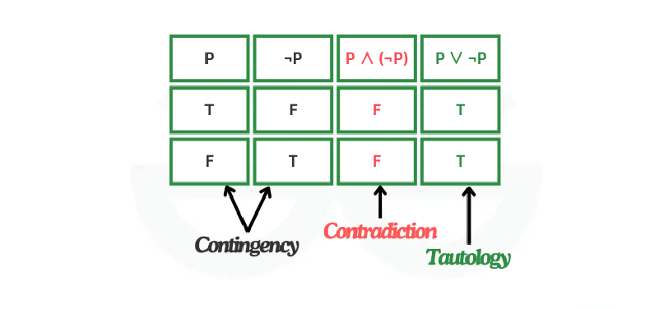
Tautology
A tautology is a statement in logic and mathematics that is always true regardless of the truth values of its individual components.
Logical Statement: The statement "If it is raining, then it is raining" is a tautology because it is always true.

Slide 18
MCQs
Which of the following is a valid statement in propositional logic?
A) 𝑃∧(𝑄∨𝑅)
B) 𝑃𝑄𝑅
C) 𝑃+𝑄
D) 𝑃⊕𝑄
What is the truth value of the proposition 𝑃∧¬𝑃?
A) True
B) False
C) It depends on 𝑃
D) Undefined
Which of the following is not a tautology?
A) 𝑃∨¬𝑃
B) 𝑃∧¬𝑃
C) 𝑃→(𝑄∨¬𝑄)
D) ¬(𝑃∧¬𝑃)
4. In propositional logic, the statement ¬(𝑃∨𝑄) is equivalent to:
A) ¬𝑃∧𝑄
B) ¬𝑃∧¬𝑄
C) ¬𝑃∨¬𝑄
D) 𝑃∧¬𝑄
5. Which of the following logical connectives is not binary?
A) ∧
B) ∨
C) ¬
D) →

Slide 19
Answers
A
B
B
B
C

Slide 20
Summary / Key Points
Propositional logic provides an essential framework in formal logic, with broad applications in mathematics, computer science, and philosophy.
Propositional logic handles simple true/false statements and their combinations using logical connectives.

Slide 21
Reference Material
Artificial Intelligence: A Modern Approach, 4th Ed., Stuart Russell & Peter Norvig
https://courses.engr.illinois.edu/cs173/fa2020/Lectures/Notes/LogicNotes.pdf
https://www.youtube.com/watch?v=Iiu8aVhmidY
https://formal.kastel.kit.edu/~beckert/teaching/Verification-SS06/02logic.pdf

Slide 22
Coming Up Next - Predicate Logic

Slide 23

Thank You

